Slide 1
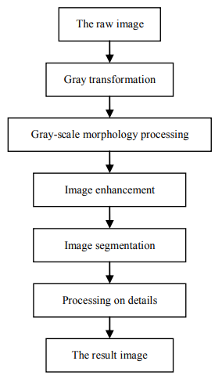
Method

Slide 2
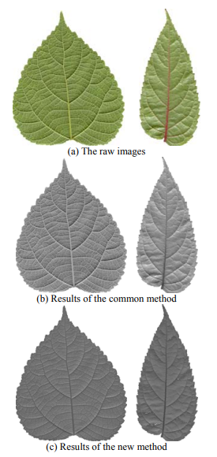
1. Gray transformation
In RGB color space:
Y = 0.299R + 0.587G + 0.114B
In HSV color space:
Y = (((H+90) % 360) / 90 + 1 – V) / 2
Notes:
-> Bỏ saturation -> bỏ độ đậm đà

Slide 3
Texture Feature Extraction for Identification of Medicinal Plants and Comparison of Different Classifiers
C. H. Arun, W. R. Sam Emmanuel, D. Christopher Duraira, 2010

Slide 4
First order statistical features
The distribution of gray levels

Slide 5

First order statistical features
$x_{i}$là biến ngẫu nhiên kí hiệu cho mức xám trong ảnh và L là số mức xám khác nhau.
P($x_{i}$) là xác suất xuất hiện pixel có giá trị $x_{i}$, P($x_{i}$) = $\frac{k}{N}$ (N là tổng số pixel trong region, k là số pixel có mức xám $x_{i}$)

Slide 6
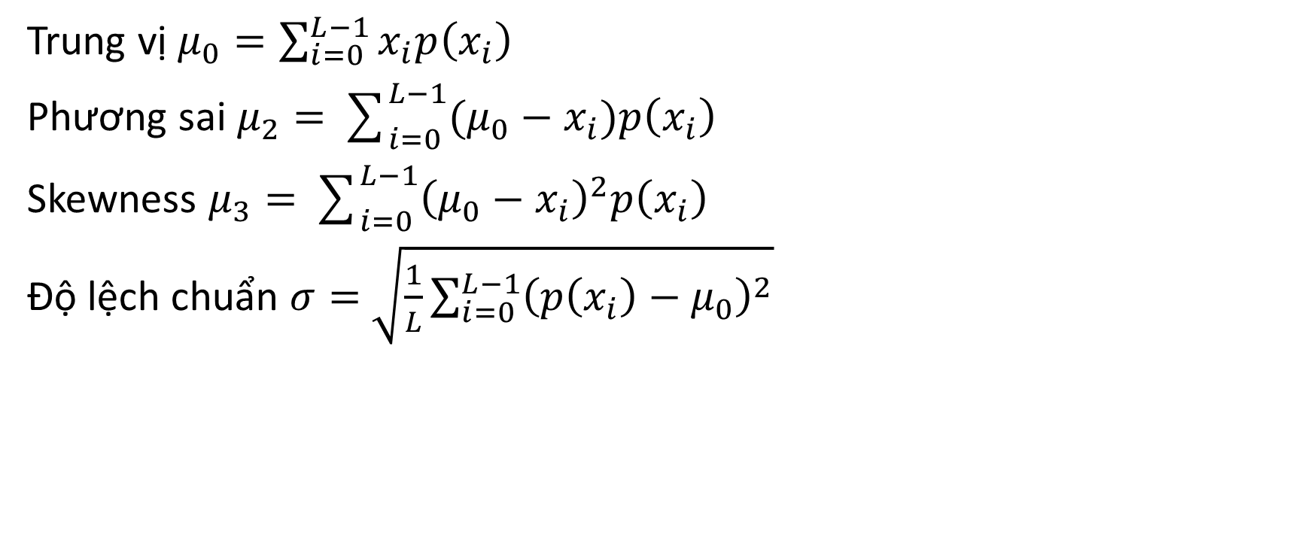
First order statistical features
Trung vị $μ_{0}=\sum_{i=0}^{L−1}{x_{i}p\left(x_{i}\right)}$
Phương sai $μ_{2}=\sum_{i=0}^{L−1}{({μ_{0}−x}_{i})p\left(x_{i}\right)}$
Skewness $μ_{3}=\sum_{i=0}^{L−1}{{\left({μ_{0}−x}_{i}\right)}^{2}p\left(x_{i}\right)}$
Độ lệch chuẩn $σ=$ $\sqrt{\frac{1}{L}\sum_{i=0}^{L−1}{{\left(p\left(x_{i}\right)−μ_{0}\right)}^{2}}}$

Slide 7
Second order statistical features
The relative positions of the various gray levels

Slide 8
Leaf image
Normalization
Gray image
Symmetry
Quantization
Co-occurrence Matrix

Slide 9
Leaf image
Normalization
Gray image
Symmetry
Quantization
Co-occurrence Matrix

Slide 10

1. Quantization
To reduces the number of gray tones (256) $→$ …

Slide 11
Leaf image
Normalization
Gray image
Symmetry
Quantization
Co-occurrence Matrix

Slide 12
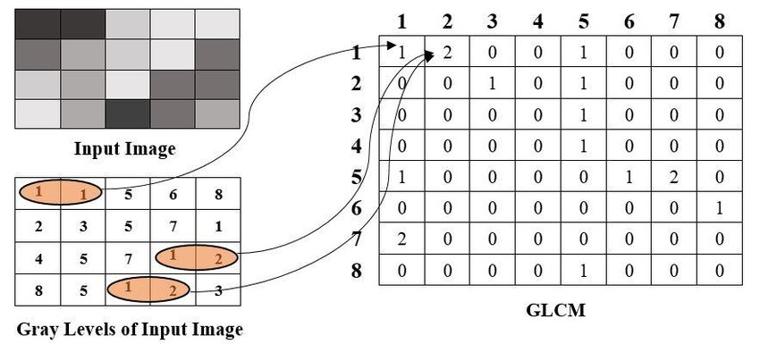

2. Gray-Level Co-Occurrence Matrix
$$d=0, θ=0$$

Slide 13
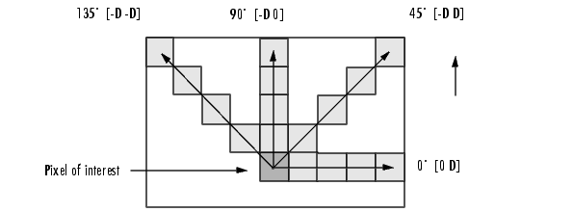

2. Gray-Level Co-Occurrence Matrix
$$d=3$$

Slide 14

2. Grey Tone Spatial Dependency Matrix(GTSDM)
Với mỗi $σ\left(d,θ\right),$ chúng ta có ma trận k x k $G$, $G\left(i,j\right)=$ tần suất xuất hiện pixel có grey level j tình từ pixel grey level i (k: number of grey levels).
VD: $d=1..4, θ=0°,45°,90°,135°$. Input image $≈16 Gs$

Slide 15
Leaf image
Normalization
Gray image
Symmetry
Quantization
Co-occurrence Matrix

Slide 16
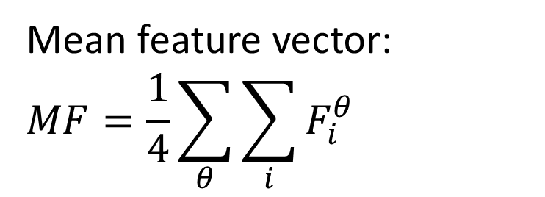

3. Symmetry
To make G symmetrical, transposed G into G’:
$$S=G+G′$$
Normalised:
$$S=\frac{S}{\sum_{i}{\sum_{j}{S_{i,j}}}}$$
Entropy:
$$ε=−\sum_{i=1}^{k}{\sum_{j=1}^{k}{S_{i,j}log⁡(S_{i,j})}}$$
Mean feature vector:
$$MF=\frac{1}{4}\sum_{θ}{\sum_{i}{F_{i}^{θ}}}$$

